Slide 1
Intro to Structural Equation Modeling (SEM)
Jimmy Zhang
GC3 Event

Slide 2
What is SEM?
A set of statistical techniques used to measure and analyze the relationships of observed and latent variables.
Factor analysis
Path analysis
Regression
…
It takes a confirmatory (i.e., hypothesis-testing) approach to the analysis of a structural theory
Theory-based
Supported by substantive knowledge
NOT “peaking at the data”

Slide 3
Why SEM?
Compared to traditional regression analyses, it:
Includes latent variables that will control measurement error
Allows a way to compare model fit to the observed data
can be used to test complex model structures
Can combine complex path models involving latent variables
HOWEVER…
It needs large sample size (N > 200 for general purposes)
Sometimes misused for causality

Slide 4
Why SEM?
By identifying and reducing the sources of measurement error, we can make more explicit and precise theoretical inferences than those based on ordinary multiple regression or simple comparisons of means/proportions.
SEM framework can do a lot:
ANOVA
Multiple regression
Path analysis
Confirmatory factor analysis
Latent class analysis
Usually used SEM softwares: Amos, EQS, LISREL, Mplus, R(sem, lavaan), Stata, SAS, etc.

Slide 5
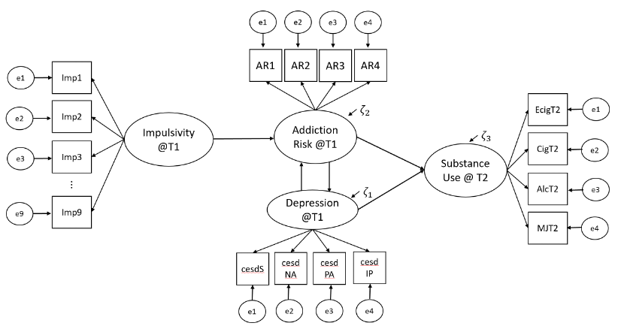
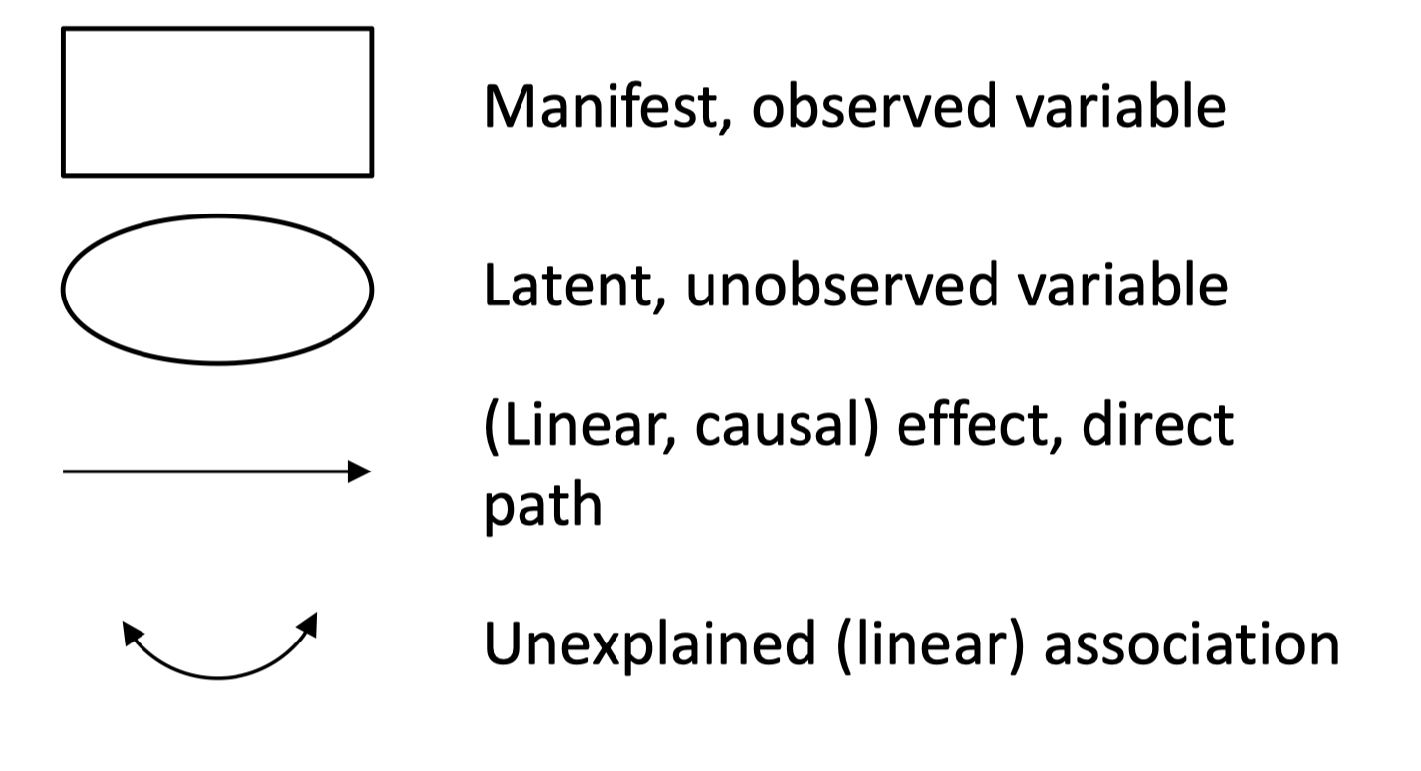
What does SEM look like?
-Graphical devices for SEM

Slide 6
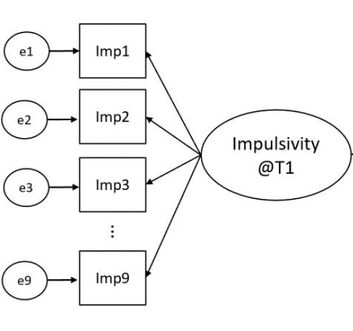
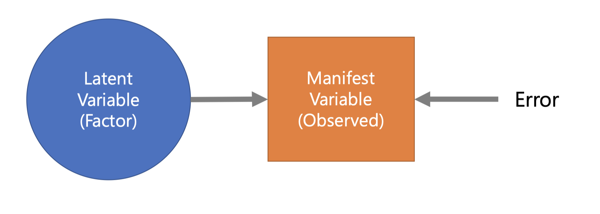
Latent variable and Factor Analysis
A theoretical entity or construct that is used to explain one or more manifest variables.
Cannot be directly observed or measured.
Approximated through various measures presumed to assess part of the given construct.
Factor analysis is a statistical method used to describe relationships of a set of observable variables by latent variables/factors.

Slide 7
Path Analysis
-How about interrelationships among latent variables?

Slide 8
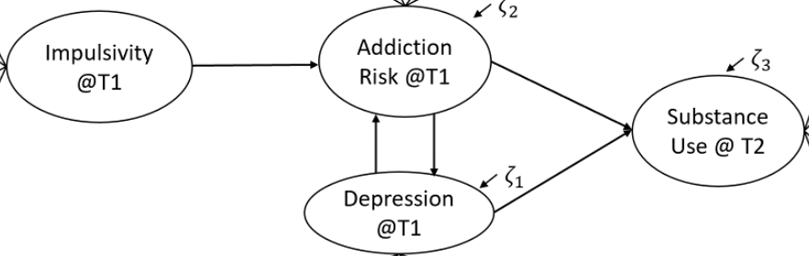
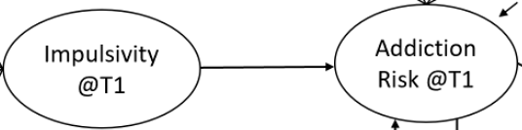
Path Analysis
In research we are accustomed to a paradigm in which there are only two types of variables: independent and dependent.
What we usually do is fitting a regression model between these variables.
BUT what if our hypothesis is way more complicated? (e.g., mediators, reciprocal relations, etc.)
Path analysis allows for complex models in which there are several dependent variables in causal chains.
HOWEVER, path models are only able to determine the extent to which the data are consistent with the model. It DOES NOT necessarily indicate a causal relationship.
To determine a causal relationship, we need satisfying research design and grounded theory with substantive background knowledge.

Slide 9
Path Analysis
In path analysis,
Predicted variables (Y) are referred to as endogenous.
Independent variables (X) are referred to as exogenous.

Slide 10
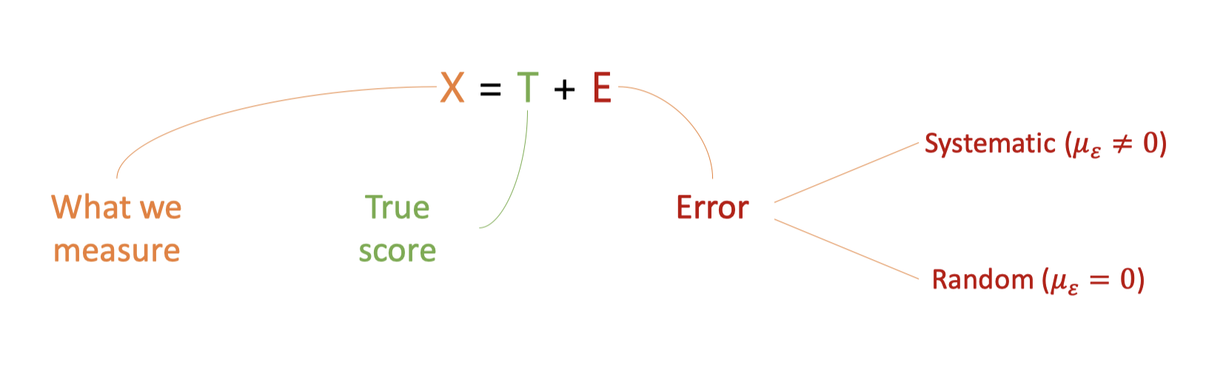
An Important Revisit:
-Measurement Error
Any given observation X reflects a mix of a true score and some level of measurement error.
Why does SEM control for measurement error?
Latent variables are not directly measured and do not have measurement error associated with them. This is kind of a big deal because if we can estimate the association of latent variables, we can estimate the relations among variables without measurement error.

Slide 11
Intro to Full SEM Model
Basically and visually…
Can combine complex path models involving latent variables.
Main interest is on theoretical constructs and the relationship among them
Theory is always your guide.
This is NOT a data-driven method.
From the name (Structural equation modeling), we can think of it in two components:
Structural model
Measurement model
Deals with the relationship between a latent variable and its indicators.
Defines the relationship between the various constructs

Slide 12
Five Steps in SEM Analyses
Theory to Data:
Form basic ideas of merging theory and data
Specification:
Form explicit hypotheses using regression and factor analysis concepts to form “structural” restrictions
An illustration of your SEM model using graphical devices may be helpful.
Estimation:
Use software to fit your model to data.
Estimate coefficients, standard errors and various statistical indicators.
Evaluation:
Look at various model indices and check all the restrictions.
Compare alternative structural restrictions in a series of statistical tests.
Re-evaluation & extension:
“Explore” new ideas/models if your proposed model is not well-fitted.
Be careful of “driven by data”
A prepared alternative model may help.

Slide 13
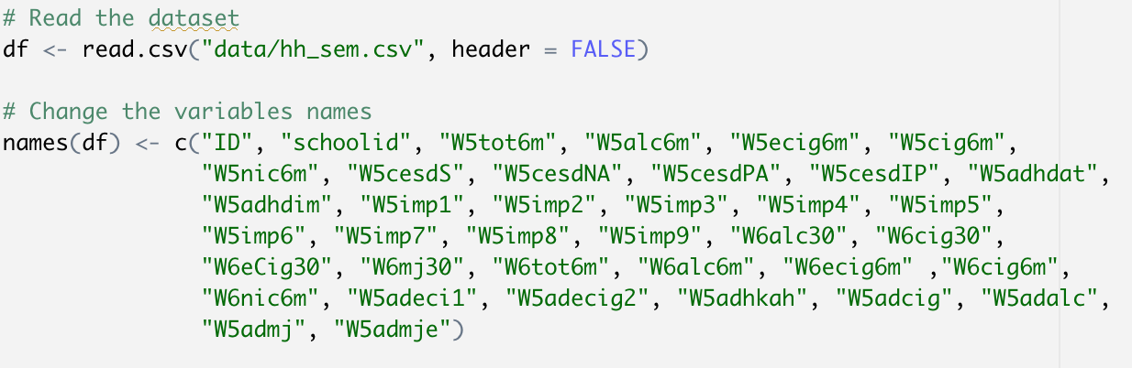
Example 1: Confirmatory Factor Analysis
Step 1: Form a basic idea of your model after obtaining the data.
In this dataset, there is a possible latent construct (variable: impulsivity for substance use.
Why is this idea valid?
Through research design: 9 items intending to test this abstract concept.
You should also consider past literature/substantive knowledge in your area, and then carefully build up your model in advance.

Slide 14
Example 1
Step 2: Model specification
Since we are clear that impulsivity should be reflected through 9 related indicators, we can now formally construct this model with visualization.

Slide 15
Example 1
Step 3: Fit your model and obtain fitting estimates
In this workshop, we’ll use a R package <lavaan> to fit the model.
Model syntax in lavaan:
~: the regression operator (e.g., y1 ~ x1)
=~: “is measured by” (e.g., impulsivity =~ w5imp1 + … + w5imp9)
~~: variance/covariance (e.g., variance: y1 ~~ y1; covariance: y1 ~~ y2)
~1: intercepts

Slide 16
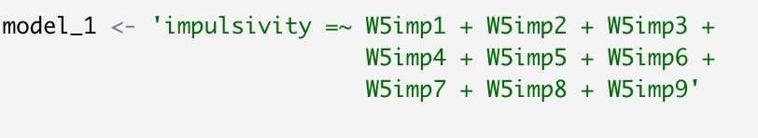
Example 1:

Slide 17
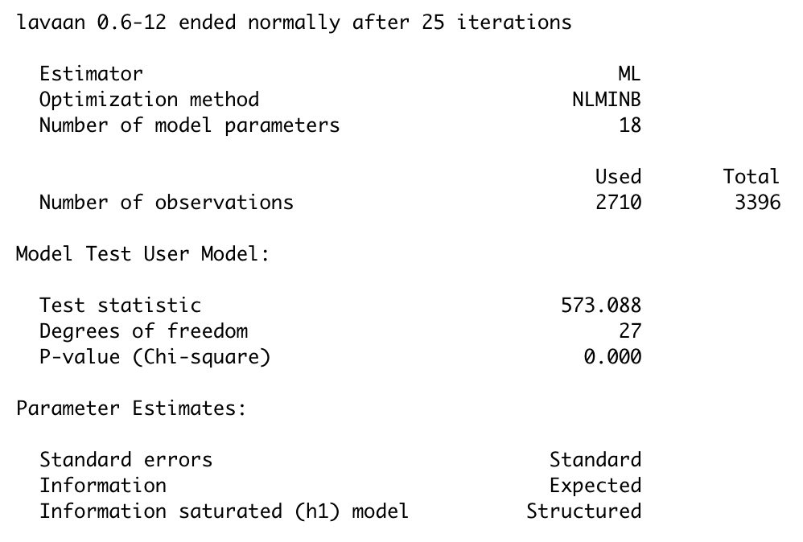
Example 1: Model Evaluation (Step 4)

Slide 18
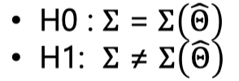
Example 1
Step 4: Model evaluation
Some questions you should think about:
Is the direction of the signs of the results reasonable?
Do the standard errors look reasonable?
Does the level of statistical significance look reasonable?
Do the amount of variance explained look reasonable?
Model Indices:
Chi-square: If the chi-square is not significant, the model is regarded as acceptable.
HOWEVER, chi-square is sensitive to sample size and model complexity
Discrepancy function: CFI, NFI, TLI, and IFI
Information theory: AIC, BCC, BIC, and CAIC

Slide 19
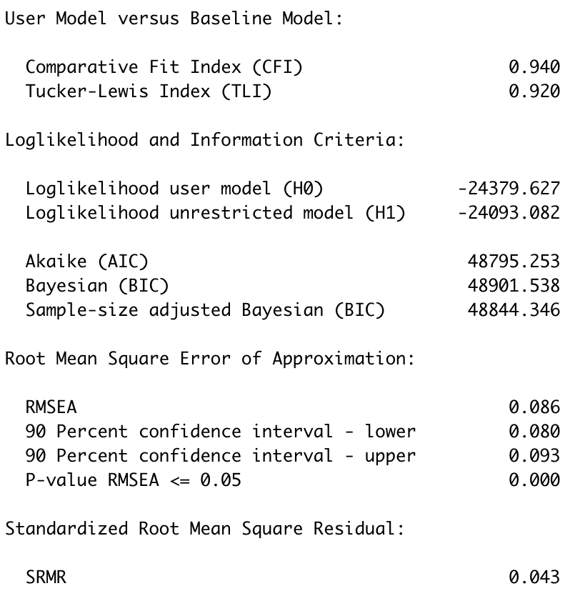

Slide 20
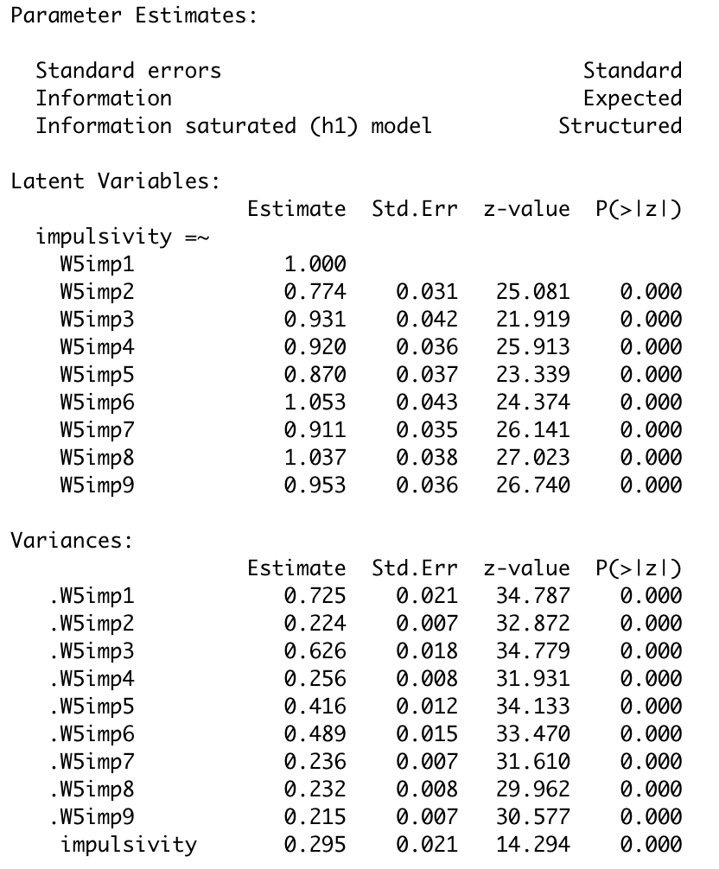

Slide 21
Example 2: Full SEM
You’re welcome to clone the git resource to try it out on your own. Please let us know if you have any questions!
Git repo: https://github.com/Gengrui-Zhang/GC3_IntroSEM.git
Use the data named “hh_sem.csv”

Slide 23
Acknowledgement
This presentation is adapted from Dr. Mark Lai’s presentation at the University of Cincinnati, and Dr. Trevor Pickering & Dr. Jimi Huh’s SEM course materials. The dataset shared in this workshop is originally from Dr. Trevor Pickering & Dr. Jimi Huh’s SEM class. Thanks for Dr. Mark Lai, Dr. Trevor Pickering, and Dr. Jimi Huh!

Slide 24
Questions? Concerns?
Thanks for attending!

